Slide 1
THE HEALTH EFFECTS OF ELECTRONIC CIGARETTES
Pebbles Fagan, PhD, MPH
Professor
University of Arkansas for Medical Sciences
23rd Arkansas Cancer Summit and 19th Clearing the Air in Communities of Color Conference, 2022
March 8, 2022

Slide 2
Goals for Today
Discuss
Prevalence of electronic cigarette (e-cigarette) use.
Provide
Overview of the health effects of e-cigarettes.
Describe
Results from the concept mapping study.
Discuss
FDA regulatory actions and health impacts.

Slide 3
Prevalence of e-cigarette use

Slide 4
E-cigarette Prevalence among Youth, National Youth Tobacco Survey, CDC 2021
11.3% current use among high school students, 43% use them 20-30 days of the month.
2.8% current use among middle school students, 17% use them 20-30 days of the month.
In 2019, 4.5% of adults used e-cigarettes.
Among youth, disposables are most commonly used (53%), followed by pre-fill/refillable (28.7%), and tanks or mod systems (9.0%).
The most commonly used brands are Puff Bar (26%), Vuse (10%), SMOK(8.6%), JUUL (6.8%), Sourin (2.1), some other brand (19.8%), no usual brand (2.4%)
84% of youth used a flavored product.
70% used fruit
34% used candy, sweet, or dessert
30% use mint
29% use menthol
Park-Lee E, Ren C, Sawdey MD, et al. Notes from the Field: E-Cigarette Use Among Middle and High School Students — National Youth Tobacco Survey, United States, 2021. MMWR Morb Mortal Wkly Rep 2021;70:1387–1389. DOI: http://dx.doi.org/10.15585/mmwr.mm7039a
Notes:
E-devices have rapidly evolved since entering the international market in 2013, with vape pens, box mods, and pod-based devices being the most commonly used vaping devices in 2020 [3].

Slide 5
Overview of the health effects of e-cigarettes

Slide 6
Factors Influencing Health Effects of E-cigarettes
Toxicity and variance by product type and engineering, e-liquid characteristics, user
Constituents
Nicotine type and amount
Flavorants- type and amount
Propylene glycol (PG)
Glycerin
Product types
Voltage
Air flow
Topography
Puff length
Interval between puffs
User characteristics
Age
Gender
Experience
Health status
Particle size- influences pulmonary absorption

Slide 7
Types of Health Effects
Physiological
Secondhand and thirdhand exposures
Harm reduction
Combustible tobacco cessation
Disease outcomes

Slide 8
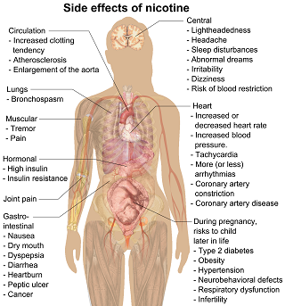
Nicotine and Health Effects
Nicotine independently has health effects.
Brain development
Addiction
Heart disease and blood pressure
Insulin
Nicotine alone can influence tumor progression and cancer cell migration
Pregnancy and birth outcomes

Slide 9
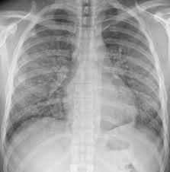
E-cigarette or Vaping Product use-Associated Lung Injury
There is substantial evidence associating vitamin E acetate with many cases of EVALI, there are other adulterants that likely are responsible in a subset of cases.

Slide 10
Studies on Health Effects of E-Cigarettes
Health Effects | Reference | Year | Summary
Health impact | Callahan-Lyon P. Electronic cigarettes: human health effects. Tob Control. 2014 May;23 Suppl 2:ii36-40. | 2014 | Inconclusive
Cardiovascular | Franzen KF, Willig J, Cayo Talavera S, et al. . E-cigarettes and cigarettes worsen peripheral and central hemodynamics as well as arterial stiffness: a randomized, double-blinded pilot study. Vasc Med. 2018;23(5):419–425 | 2018 | Franzen et al reported that users of nicotine-containing e-cigarettes or conventional cigarettes had greater arterial stiffness, higher systolic and diastolic blood pressure, and a higher heart rate compared with subjects not exposed to nicotine.
Cardiovascular disease | Skotsimara G, Antonopoulos AS, Oikonomou E, Siasos G, Ioakeimidis N, Tsalamandris S, Charalambous G, Galiatsatos N, Vlachopoulos C, Tousoulis D. Cardiovascular effects of electronic cigarettes: A systematic review and meta-analysis. Eur J Prev Cardiol. 2019 Jul;26(11):1219-1228. | 2019 | The meta-analysis of 14 studies (N + 441 participants) suggested that there are acute effects of the electronic cigarette on heart rate , diastolic, and systolic blood pressure. But, blood pressure may improve benefits when switching.
Effects of nicotine | McGrath-Morrow SA, Gorzkowski J, Groner JA, Rule AM, Wilson K, Tanski SE, Collaco JM, Klein JD. The Effects of Nicotine on Development. Pediatrics. 2020 Mar;145(3) | 2020 | Preclinical and clinical studies indicate that nicotine exposure alone has the potential to cause developmental abnormalities, harm childhood health, and addict a new generation of adolescents and young adults. This include mental health concerns, suicide by nicotine, nicotine intoxication. Nicotine alone can influence tumor progression and cancer cell migration. Preclinical and smoke studies indicate that nicotine can alter antimicrobial and inflammatory responses, impact mucociliary clearance in the airways, and impact lung development.
 |  |  | Cross-sectional studies in adolescent users of e-cigarettes have revealed an association between e-cigarette use and chronic bronchitis symptoms, self-reported doctor diagnosis of asthma, higher rates of respiratory symptoms, and greater school absenteeism due to asthma.
Nicotine delivery | Voos N, Goniewicz ML, Eissenberg T. What is the nicotine delivery profile of electronic cigarettes? Expert Opin Drug Deliv. 2019 Nov;16(11):1193-1203. | 2019 | Modern e-cigarettes have the potential to deliver equal or more nicotine compared to a tobacco cigarette. Future research needs to identify the nicotine delivery profiles likely to benefit public health and the means to regulate them while also identifying those that are likely to cause harm.
Dependence | Vogel EA, et al. Adolescents’ e-cigarette use: increases in frequency, dependence, and nicotine exposure over 12 months. J Adolesc Health. 2019;64(6):770–775 | 2019 | Of adolescents who only used e-cigarettes, 80.3% were still using 12 months later, daily use increased from 14.5% to 29.8%, and tobacco smoking initiation occurred in 28.8%.⁵

Slide 11
Studies on Health Effects of E-Cigarettes
Health Effects | Reference | Year | Summary
Oral Health | Holliday R, Chaffee BW, Jakubovics NS, Kist R, Preshaw PM. Electronic Cigarettes and Oral Health. J Dent Res. 2021 Aug;100(9):906-913 | 2021 | Microbiological studies have indicated that e-cigarette users have a distinct microbiome, and there is some indication this may be more pathogenic compared to nonusers. There are abnormalities in oral cells in vitro, but the significance of these biological effects in vivo is currently unclear.
Second-hand smoke | Li L, Lin Y, Xia T, Zhu Y. Effects of Electronic Cigarettes on Indoor Air Quality and Health. Annu Rev Public Health. 2020 Apr 2;41:363-380. | 2020 | The use of e-cigs in indoor environments leads to high levels of fine and ultrafine particles similar to tobacco cigarettes (t-cigs). Concentrations of chemical compounds in e-cig aerosols are generally lower than those in t-cig smoke, but a substantial amount of vaporized propylene glycol, vegetable glycerin, nicotine, and toxic substances, such as aldehydes and heavy metals, has been reported.
Cancer | Szukalska, M., Szyfter, K., Florek, E., Rodrigo, J. P., Rinaldo, A., Mäkitie, A. A., Strojan, P., Takes, R. P., Suárez, C., Saba, N. F., Braakhuis, B., & Ferlito, A. (2020). Electronic Cigarettes and Head and Neck Cancer Risk-Current State of Art. Cancers, 12(11), 3274. | 2020 | There is some evidence suggesting a potentially carcinogenic role of e-cigarettes in the pathogenesis of HNCs presented in original papers. Most of the available articles report basic laboratory experiments or cohort studies with small sample sizes, and are limited in their design, methodology, and the used exposure time and lack of long-term follow-up.
Cessation | Chen R, Pierce JP, Leas EC, White MM, Kealey S, Strong DR, Trinidad DR, Benmarhnia T, Messer K. Use of Electronic Cigarettes to Aid Long-Term Smoking Cessation in the United States: Prospective Evidence From the PATH Cohort Study. Am J Epidemiol. 2020 Dec 1;189(12):1529-1537. | 2020 | Two-thirds of those who successfully used e-cigarettes to attain long-term abstinence from cigarettes were still using e-cigarettes during the follow-up year.
COVID-19 | Gaiha SM, Cheng J, Halpern-Felsher B. Association Between Youth Smoking, Electronic Cigarette Use, and COVID-19. J Adolesc Health. 2020 Oct;67(4):519-523. | 2020 | COVID-19 diagnosis was five times more likely among ever-users of e-cigarettes only , seven times more likely among ever-dual-users, and 6.8 times more likely among past 30-day dual-users. COVID-19 testing was nine times more likely among past 30-day dual-users and 2.6 times more likely among past 30-day e-cigarette only users. COVID-19 symptoms were 4.7 times more likely among past 30-day dual-users.
Birthweight | McDonnell BP, Dicker P, Regan CL. Electronic cigarettes and obstetric outcomes: a prospective observational study. BJOG. 2020 May;127(6):750-756. | 2020 | The birthweight of infants born to EC users is similar to that of non-smokers, and significantly greater than cigarette smokers. Dual users of both cigarettes and EC have a birthweight similar to that of smokers.

Slide 12
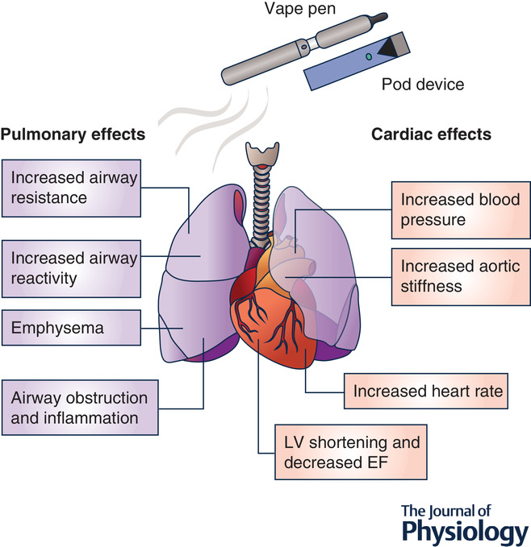
Effects of e‐cigarettes and vaping devices on cardiac and pulmonary physiology
The Journal of Physiology, Volume: 598, Issue: 22, Pages: 5039-5062, First published: 25 September 2020, DOI: (10.1113/JP279754)
Notes:
IF THIS IMAGE HAS BEEN PROVIDED BY OR IS OWNED BY A THIRD PARTY, AS INDICATED IN THE CAPTION LINE, THEN FURTHER PERMISSION MAY BE NEEDED BEFORE ANY FURTHER USE. PLEASE CONTACT WILEY'S PERMISSIONS DEPARTMENT ON PERMISSIONS@WILEY.COM OR USE THE RIGHTSLINK SERVICE BY CLICKING ON THE 'REQUEST PERMISSIONS' LINK ACCOMPANYING THIS ARTICLE. WILEY OR AUTHOR OWNED IMAGES MAY BE USED FOR NON-COMMERCIAL PURPOSES, SUBJECT TO PROPER CITATION OF THE ARTICLE, AUTHOR, AND PUBLISHER.
Ejection Fraction (EF)
Left ventricle (LV)

Slide 13
To date, no e-cigarette has been approved as a cessation device or authorized to make a modified risk claim, and more research is needed to understand the potential risks and benefits these products may offer adults who use tobacco products.

Slide 14
Results from the concept mapping study

Slide 15
Prompt: "A specific negative effect or symptom related to my breathing, nose, mouth, throat, or lungs that I have experienced from vaping/using my e-cigarette is..." Participants sorted the final list of 56 statements into groups of similar content and rated statements on how true they were for them. Multidimensional scaling analysis identified thematic clusters.

Slide 16
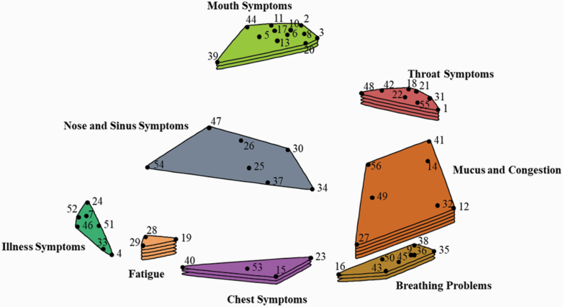
Results: User Identified Respiratory Symptoms
Fatigue- low stamina
Chest symptom- pain, tightness, heart palpitations
Illness symptoms- headache, dizziness, sick more often
Mucus and congestion- nasal, chest, more mouth breathing
Breathing problems- cough, shortness of breath, wheezing.
Mouth symptoms- bad taste, dry mouth, sore tongue, mouth sores, tooth decay.
Nose and sinus symptoms- runny nose, burning in nose, swollen lymph nose.
Throat symptoms- sore throat, burning, itchy

Slide 17
Summary of Results
Participants identified 56 unique respiratory-related symptoms that grouped into eight thematic clusters.
Broadly, these symptoms indicated ECIG use may affect many parts of the body involved in the respiratory system including the mouth, nose, throat, and lungs as well as those indirectly related to the respiratory system.
As a result, some ECIG users perceived their ECIG use may contribute to general illness symptoms, cardiovascular system problems, and fatigue.
Many of these symptoms appeared similar to those experienced by cigarette smokers; however, some symptoms appeared to be unique to ECIG use, such as those related to a metallic taste in the mouth or postnasal drip that tastes like ECIG liquid.

Slide 18
FDA regulatory actions and health impacts

Slide 19
FDA and Premarket Tobacco Product Application
A Premarket Tobacco Product Application (PMTA) can be submitted by any person for any new tobacco product seeking an FDA marketing order, under section 910(b) of the Federal Food, Drug, and Cosmetic (FD&C) Act. A PMTA must provide scientific data that demonstrates a product is appropriate for the protection of public health. In order to reach such a decision and to authorize marketing, FDA considers (per section 910(c)(4), among other things:
Risks and benefits to the population as a whole, including people who would use the proposed new tobacco product as well as nonusers;
Whether people who currently use any tobacco product would be more or less likely to stop using such products if the proposed new tobacco product were available; and
Whether people who currently do not use any tobacco products would be more or less likely to begin using tobacco products if the new product were available

Slide 20
FDA Review of Other E-cigarette Applications
Applications for many ENDS and other new deemed tobacco products on the market as of Aug. 8, 2016 were required to be submitted to FDA by Sept. 9, 2020.
FDA has taken action on over 98% of the applications submitted by that deadline. This includes issuing MDOs for more than one million flavored ENDS products that lacked sufficient evidence that the benefit to adult smokers who used the flavor products would overcome the public health concern posed by the well-documented and considerable appeal of the products to youth.
FDA posted a sample MDO decision summary.

Slide 21
Language from Sample Letter by FDA to Industry
These applications for flavored ENDS products lack evidence to demonstrate that permitting the marketing of these products would be appropriate for the protection of the public health (APPH). Given the known and substantial risk of flavored ENDS with respect to youth appeal, uptake, and use, applicants would need reliable and robust evidence of a potential benefit to adult smokers that could justify that risk. Accordingly, in order to show that a flavored ENDS is appropriate for the protection of public health, the applicant must show that the benefit to adults switching from or reducing cigarettes outweighs the risk to youth.
https://www.fda.gov/media/152504/download

Slide 22
2021 FDA Approved Premarket Tobacco Product Marketing Orders (n=7)
Manufacturer | Product Name and Order Letter | Product Category | Date Issued | Decision Summary
U.S. Smokeless Tobacco Company LLC | VERVE® Discs Blue Mint | Other | 10/19/2021 | PM0000470
U.S. Smokeless Tobacco Company LLC | VERVE® Chews Blue Mint | Other | 10/19/2021 | PM0000471
U.S. Smokeless Tobacco Company LLC | VERVE® Discs Green Mint | Other | 10/19/2021 | PM0000472
U.S. Smokeless Tobacco Company LLC | VERVE® Chews Green Mint | Other | 10/19/2021 | PM0000473
R.J. Reynolds Vapor Company | Vuse Solo Power Unit | ENDS | 10/12/2021 | PM0000551
R.J. Reynolds Vapor Company | Vuse Replacement Cartridge Original 4.8% G1 | ENDS | 10/12/2021 | PM0000553
R.J. Reynolds Vapor Company | Vuse Replacement Cartridge Original 4.8% G2 | ENDS | 10/12/2021 | PM0000560

Slide 23
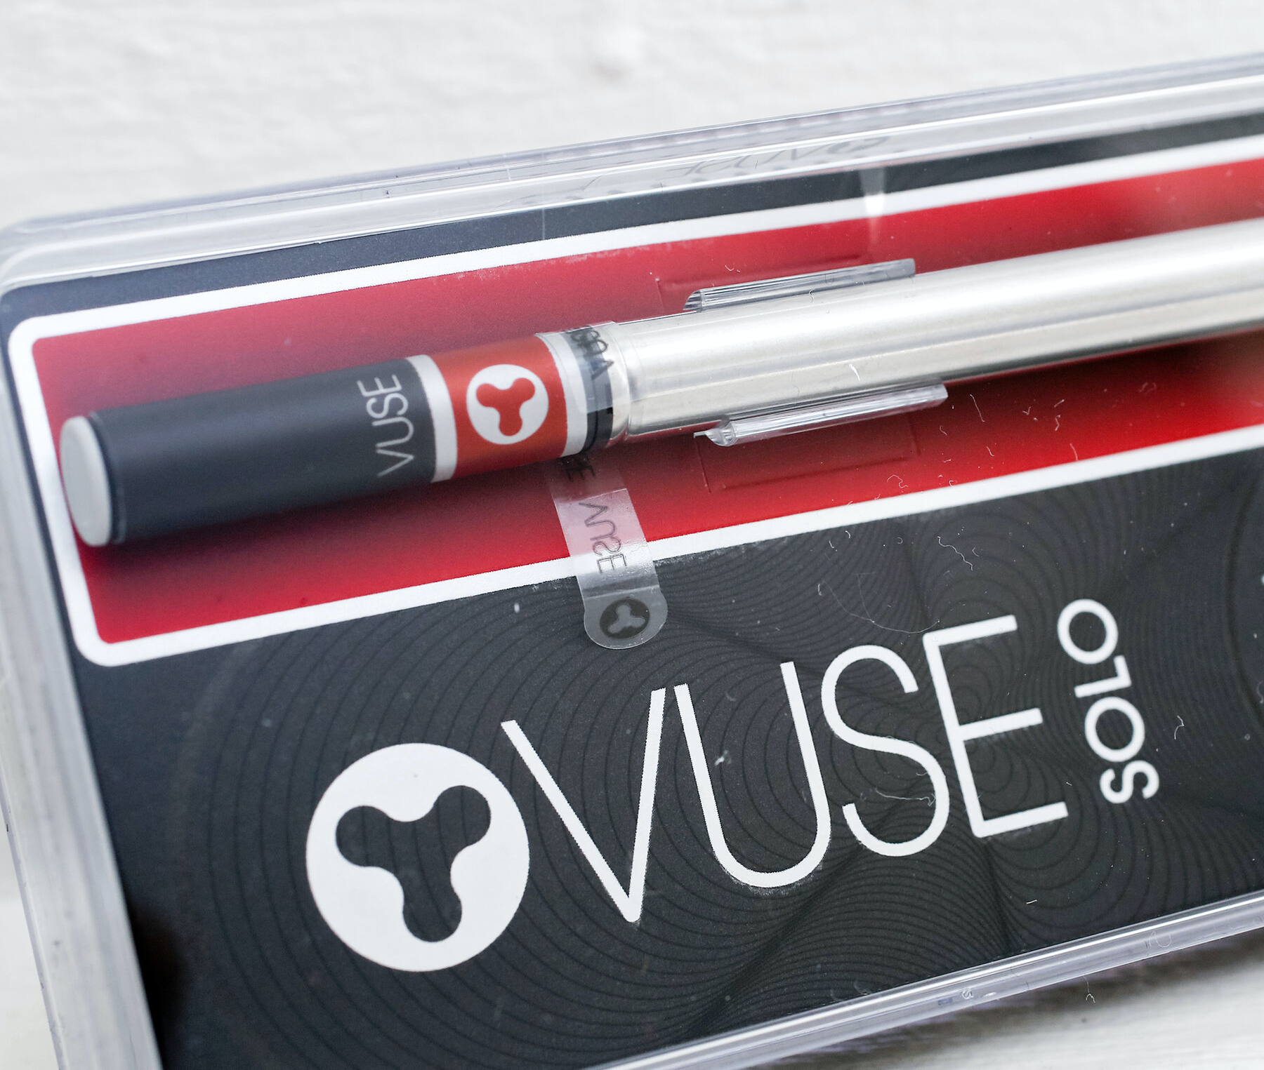
New E-cigarette/Vaping Products that FDA Approved for Marketing by Tobacco Industry
On October 12, 2021, FDA approved marketing of 3 RJ Reynolds products through its Premarket Tobacco Product Application Pathway (PMTA).
Vuse Solo closed ENDS device and accompanying tobacco-flavored e-liquid pods, specifically, Vuse Solo Power Unit, Vuse Replacement Cartridge Original (tobacco) 4.8% G1, and Vuse Replacement Cartridge Original 4.8% G2.

Slide 24
FDA’s Authorization of RJ Reynold’s Vuse
“Today’s authorizations are an important step toward ensuring all new tobacco products undergo the FDA’s robust, scientific premarket evaluation. The manufacturer’s data demonstrates its tobacco-flavored products could benefit addicted adult smokers who switch to these products – either completely or with a significant reduction in cigarette consumption – by reducing their exposure to harmful chemicals,” said Mitch Zeller, J.D., director of the FDA’s Center for Tobacco Products. “We must remain vigilant with this authorization and we will monitor the marketing of the products, including whether the company fails to comply with any regulatory requirements or if credible evidence emerges of significant use by individuals who did not previously use a tobacco product, including youth. We will take action as appropriate, including withdrawing the authorization.”
https://www.fda.gov/news-events/press-announcements/fda-permits-marketing-e-cigarette-products-marking-first-authorization-its-kind-agency

Slide 25
Scientific Rationale for FDA Decision-Making: Vuse
Study participants who used only the authorized products were exposed to fewer harmful and potentially harmful constituents (HPHCs) from aerosols compared to users of combusted cigarettes.
The toxicological assessment found the authorized products’ aerosols are significantly less toxic than combusted cigarettes based on available data comparisons and results of nonclinical studies.
The FDA considered the risks and benefits to the population as a whole, including users and non-users of tobacco products, and importantly, youth.
The FDA determined that the potential benefit to smokers who switch completely or significantly reduce their cigarette use, would outweigh the risk to youth, provided the applicant follows post-marketing requirements aimed at reducing youth exposure and access to the products.
FDA is still evaluating the company’s application for menthol-flavored products under the Vuse Solo brand.

Slide 26
FDA’s Authorization of RJ Reynold’s Vuse
FDA states that while today’s action permits the tobacco products to be sold in the U.S., it does not mean these products are safe or “FDA approved.”
All tobacco products are harmful and addictive and those who do not use tobacco products should not start.

Slide 27
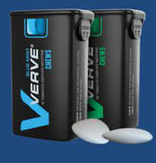
FDA’s Authorization of Altria’s Verve
The Verve products are oral tobacco products that contain nicotine derived from tobacco, but they do not contain cut, ground, powdered or leaf tobacco.
The four approved products are chewed and then discarded, rather than swallowed, once the user is finished with the product. The discs and chews differ in part by their texture.

Slide 28
Marketing and Promotion of Menthol Heated Tobacco Products
On April 30, 2019, FDA authorized the marketing of Philip Morris’ IQOS product through the premarket tobacco product application (PMTA) pathway.
On July 7, 2020, FDA authorized Phillip Morris to market IQOS as a modified risk tobacco product (MRTP) and can be marketed as an exposure modification product, but not a risk modification product.
Use of brand names is for identification and informational purposes only. It does not imply an endorsement by CDC and/or Health and Human Services of any product, service, or enterprise.

Slide 29
FDA AUTHORIZATION of Moonlight and Moonlight Menthol Cigarettes, December 2019
Cigarettes with reduced nicotine content, which at the low end may range from 0.4 to 7.4 mg per cigarette, have existed for decades, primarily for research use.
Moonlight® and Moonlight® Menthol have nicotine content between 0.2 to 0.7 mg per cigarette.
https://www.fda.gov/news-events/press-announcements/fda-permits-sale-two-new-reduced-nicotine-cigarettes-through-premarket-tobacco-product-application
Notes:
=

Slide 30
FDA Commits to Evidence-Based Actions Aimed at Saving Lives and Preventing Future Generations of Smokers
Efforts to ban menthol cigarettes, ban flavored cigars build on previous flavor ban and mark significant steps to reduce addiction and youth experimentation, improve quitting, and address health disparities, April 29, 2021
“Today, the U.S. Food and Drug Administration announced it is committing to advancing two tobacco product standards to significantly reduce disease and death from using combusted tobacco products, the leading cause of preventable death in the U.S. The FDA is working toward issuing proposed product standards within the next year to ban menthol as a characterizing flavor in cigarettes and ban all characterizing flavors (including menthol) in cigars; the authority to adopt product standards is one of the most powerful tobacco regulatory tools Congress gave the agency. This decision is based on clear science and evidence establishing the addictiveness and harm of these products and builds on important, previous actions that banned other flavored cigarettes in 2009.”
https://www.fda.gov/news-events/press-announcements/fda-commits-evidence-based-actions-aimed-saving-lives-and-preventing-future-generations-smokers
Notes:
How did we get here?

Slide 31
No combustible menthol products have been removed from the public market. How will FDA’s approval of more menthol tobacco products to enter the markets impact health among youth and adults?

Slide 32
What is harm reduction in the CONTEXT OF ELIMINATING TOBACCO RELATED HEALTH DISPARITIES?
Access to evidence-based interventions.
Efficacy of evidence-based interventions.
Interventions that target and are designed for disparate groups.
Infrastructure to support interventions for disparate groups in their communities.
Supportive policies to reduce harm to disparate groups.
Changes in social determinants that influence tobacco use and exposure.

Slide 33
Summary
E-cigarette use highest among adolescents. Use among adults has been consistently low since the product entered the market.
We know that there are short-term health effects and long-term health effects evolving. The health effects of nicotine are well established.
Our study results suggest that epidemiological studies should study health effects that users report. Such data may inform larger studies on health effects.
Need to better understand how new products on the market approved by FDA impact health among different population groups, including switching behaviors.

